Slide 1
A fracture is a complete or incomplete break in the continuity of bone or cartilage.
CLASSIFICATION OF FRACTURES
include causal factors; presence of a communicating external wound; location, morphology, and severity of the fracture; and stability of the fracture after axial reduction of the fragments.
A. Causal Factors:
Direct Violence Applied to Bone. 75% to 80% of all fracturescar accidents or motorized vehicles.
Indirect Violence. The force is transmitted through bone or muscle to a distant point where the fracture occurs (e.g., fracture of femoral neck, avulsion of tibial tubercle, fracture of condyles of the humerus or femur).

Slide 2
A. Causal Factors:
Direct Violence Applied to Bone. 75% to 80% of all fracturescar accidents or motorized vehicles.
Indirect Violence. The force is transmitted through bone or muscle to a distant point where the fracture occurs (e.g., fracture of femoral neck, avulsion of tibial tubercle, fracture of condyles of the humerus or femur).
Diseases of Bone. Some bone diseases cause bone destruction or weakening to such a degree that trivial trauma may produce a fracture (e.g., bone neoplasms, nutritional disturbances affecting bone).
Repeated Stress. Fatigue fractures in small animals are most frequently encountered in bones of the front or rear foot (e.g., metacarpal or metatarsal bones in the racing greyhound).

Slide 3
B. Presence of Communicating External Wound:
Closed Fracture. The fracture does not communicate to the outside
Open Fracture. The fracture site communicates to the outside. These fractures are contaminated or infected, and healing at best may be complicated and delayed.

Slide 4
C. Location, Fracture Morphology, and Severity:
Localization of the fracture is provided by;
numbering each long bone (1, humerus; 2, radius/ulna; 3, femur; 4, tibia/fibula) and
dividing each bone into 1, proximal; 2, shaft; and 3, distal zones.
As a measure of severity, each fracture is typed as A, simple; B, wedge; or C, complex.
Each grade is further grouped into three degrees of complexity (e.g., A1, A2, A3) depending on the type and extent of bone fragmentation.

Slide 5
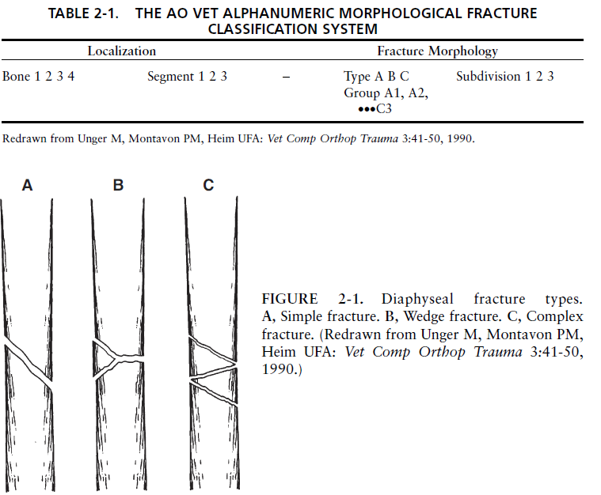

Slide 6
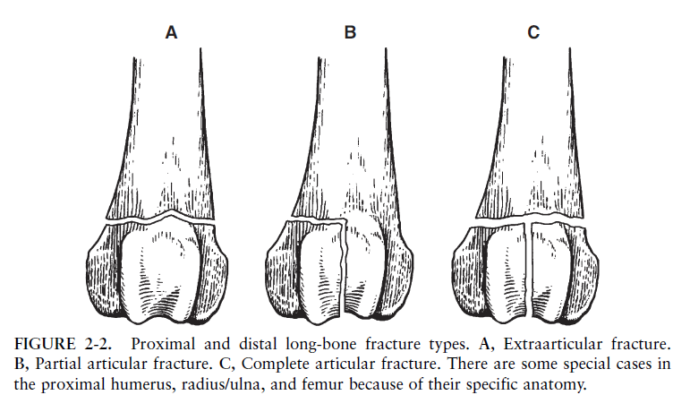
Proximal and distal zones may require individual descriptions to accommodate the specific bone morphology.

Slide 7
The orientation of the fracture line relative to the bone’s long axis allows the following descriptions:
Transverse Fracture. The fracture crosses the bone at an angle of not more than 30 degrees to the long axis of the bone.
Oblique Fracture. The fracture describes an angle of greater than 30 degrees to the long axis of the bone.
Spiral Fracture. This is a special case of oblique fracture in which the fracture line curves around the diaphysis.
Incomplete Fracture. only disrupts one cortex, an incomplete fracture is called a greenstick fracture in young animals because of the bending of the nonfractured cortex. Fissure fractures exhibit fine cracks that penetrate the cortex in a linear or spiral direction. In skeletally immature animals the periosteum is usually left intact.
Complete Fracture. A complete fracture describes a single circumferential disruption of the bone.

Slide 8
Multifragmental Fractures. Also known as comminuted fractures, multifragmental fractures have one or more completely separated fragments of intermediate size.
These fractures can be further described as follows:
Wedge fracture. A multifragmental fracture with some contact between the main fragments after reduction.
Reducible wedges. Fragments with a length and width larger than one third the bone diameter.
After reduction and fixation of the wedge(s) to a main fragment, the result is a simple fracture.
Nonreducible wedges. Fragments with a length and width less than one third the bone diameter and that result in a defect between the main fragments after reduction of more than one third the diameter.
Multiple or segmental fracture. The bone is broken into three or more segments; the fracture lines do not meet at a common point.
This is a special case of a reducible wedge fracture.

Slide 9
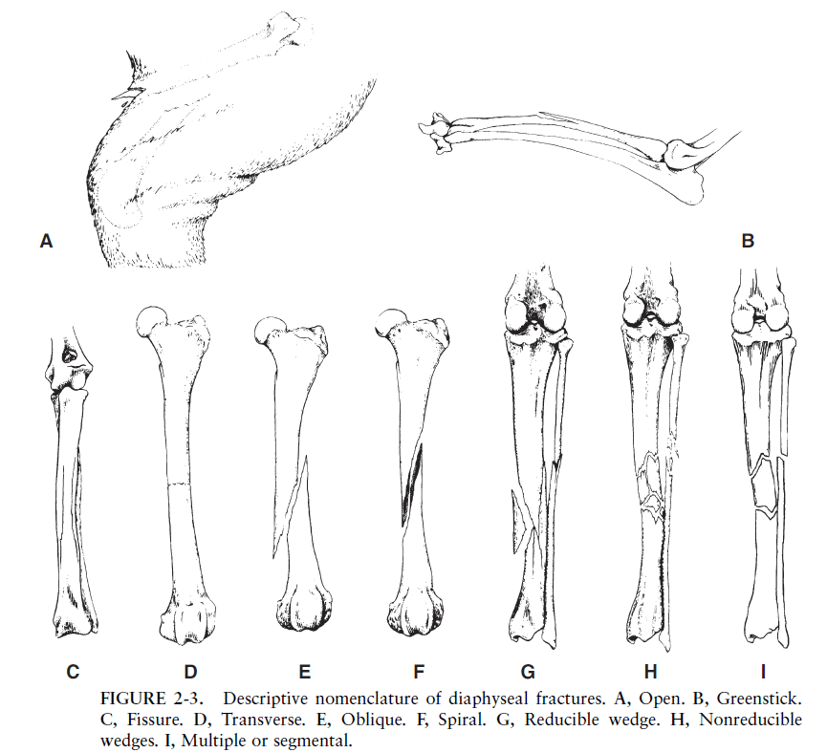

Slide 10
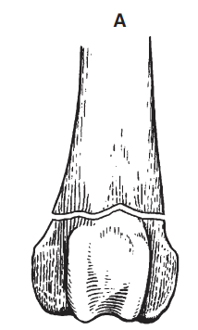
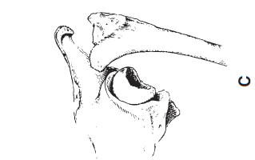
Proximal and distal metaphyseal zones require specific nomenclature to describe the wide variety of extraarticular and intraarticular fractures seen in these locations, as follows:
Extraarticular Fractures. The articular surface is not fractured but is separated from the diaphysis. These are typically called metaphyseal
fractures.
In a physeal fracture the fracture-separation occurs at the physeal line or growth plate. This type occurs only in the young, growing animal.

Slide 11
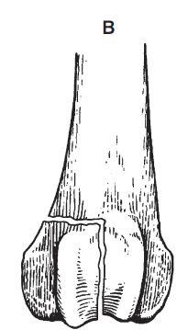
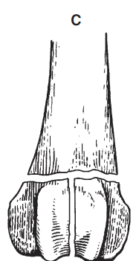
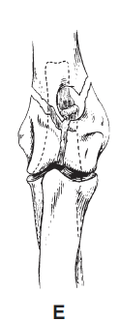
Partial Articular Fractures. Only part of the joint surface is involved, with the remaining portion still attached to the diaphysis. Unicondylar fractures are the most common example
Complete Articular Fractures. The joint surface is fractured and completely detached from the diaphysis
Humeral T or Y fractures are representative of this type

Slide 12
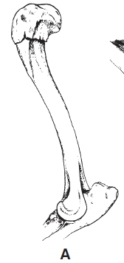
The following additional descriptive terms are applied to certain fractures:
Impacted Fracture. The bone fragments are driven firmly together.
Avulsion Fracture. A fragment of bone, which is the site of insertion of a muscle tendon, or ligament, is detached as a result of a forceful pull.

Slide 13
Stability after Replacement in Normal Anatomical Position
Stable Fracture. Fragments interlock and resist shortening forces (e.g., transverse, greenstick, impacted). The primary objective of fixation is to prevent angular and rotational deformity.
Unstable Fracture. The fragments do not interlock and thus slide by each other and out of position (e.g., oblique, nonreducible wedges). Fixation is indicated to maintain length and alignment and to prevent rotation.

Slide 14
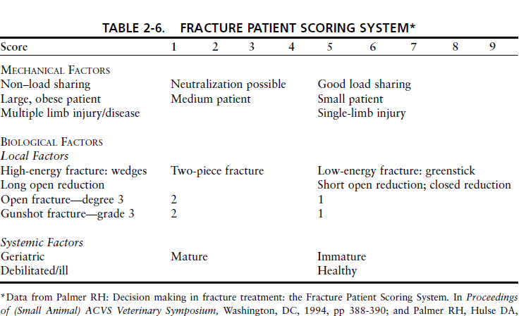

Slide 15
• Score 9 or 10
Fracture—transverse or short oblique; type A:
1. Cast/splint
2. IM pins in many, but not all cases; may be combined with interfragmentary wires.
3. Compression plate
4. External fixator, type IA
5. Interlocking nail
• Score 8 (7) to 9
Fracture—long oblique or spiral; type A and B1 one reducible wedge:
1. IM pins/cerclage-hemicerclage wires
2. Neutralization plate
3. External fixator, type I, II (may be combined with cerclage wires/lag screws)
4. Interlocking nail (may be combined with cerclage wires/lag screws)
• Score 4 (3) to 7
Fracture—wedge; type B:
1. Neutralization plate
2. External fixator, type IA double bar or IB, II (may be combined with cerclage wires/lag screws)
3. Interlocking nail (may be combined with cerclage wires/lag screws)
• Score 1 to 3
Fracture—complex; type C:
1. Buttress/bridging plate, or plate and IM pin combination
2. External fixator, type II or III
3. Interlocking nail
2—Fractures: Classification, Diagnosis, and Treatment 145

Slide 16
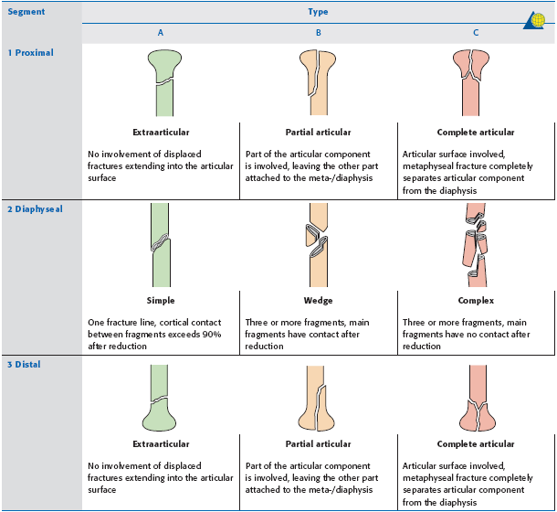

Slide 17
